Slide 1

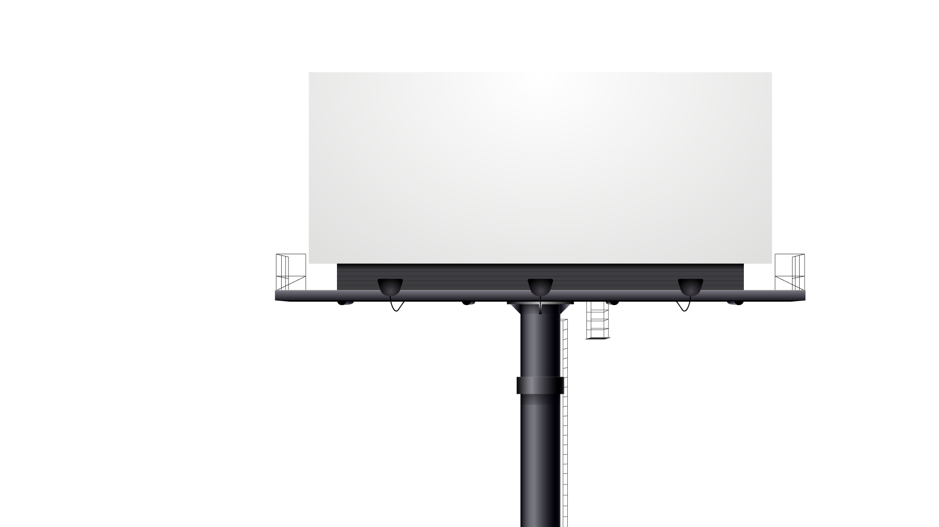

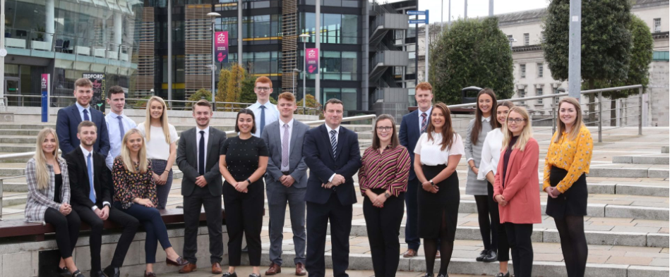
My Inspiring Growth Story at KPMG Since 2015
This presentation highlights my transformative journey at KPMG, showcasing my evolution from a newcomer to a key contributor. I have mastered intricate modules of the AMP platform, consistently delivering exceptional results in demanding environments, which has shaped my professional identity and expertise.

Slide 2

My Journey at KPMG: From Complexity to Key Contributor
A narrative of professional growth and transformation within KPMG's AMP platform
Joined KPMG in 2015
Advanced to Assistant Manager
Embarked on a career journey at KPMG, quickly becoming a part of the dynamic team that drives innovation.
Achieved the role of Assistant Manager in under four years by mastering the most challenging modules within AMP.
Trusted core team member
Earned reputation for problem-solving
Progressed from a promising newcomer to a trusted expert for critical module deliveries, showcasing reliability.
Developed a strong reputation for analytical skills by delivering on high-visibility PBIs in complex projects.

Slide 3

Delivering Under Pressure: Achieving Success Amidst Challenges
Navigating COVID-19 cutbacks and workload increases to ensure seamless operations.
Increased Responsibility
Team Collaboration
Faced with COVID-19 cutbacks and an increased workload, I assumed greater responsibility across core modules to support the team and our objectives.
Worked collaboratively with team members to address challenges, ensuring that everyone was aligned and focused on our shared goals during a difficult time.
Timely Deliverables
Client-Centric Focus
I delivered high-impact projects ahead of schedule, ensuring zero business disruption during the most challenging periods of the pandemic.
Maintained a client-centric focus throughout the process, ensuring that their needs were prioritized and any pain points were effectively addressed.
Core Module Leadership
Proactive Problem Solving
I was trusted to handle the heart of AMP—the Flowthrough module—which addressed major client pain points and was critical for client satisfaction.
Adopted a proactive approach to problem-solving, anticipating issues that could arise from the increased workload and addressing them before they impacted operations.

Slide 4













Transforming Underperformance into Client Confidence
Re-engineering critical systems to enhance performance and restore trust with clients.
Inherited underperforming module
Conducted deep-dive analysis
Re-architected the module
Tripled processing speed
Handled 30% more data
Restored client confidence
Identified root cause of dissatisfaction.
Developed a solution with stakeholder input.
Significantly improved processing capabilities.
Increased data capacity effectively.
Resolved issues and regained trust.
Faced critical performance issues.

Slide 5











Driving Innovation Through Technology Evolution
Exploring how modern advancements enhance efficiency and project delivery
AMP 2.0 Migration Achievements
UI Control Framework Implementation
Early Technology Adoption
Agentic AI and OpenAI Mastery
Advanced Frameworks Utilization
Zero post-launch issues.
25% faster feature development.
Gaining a competitive edge.
Driving project delivery success.
Enhancing developer efficiency.

Slide 6





Transforming AI & Automation: POC to Value
Leveraging AI to drive business efficiency and innovation in automation processes.
01
02
03
04
AI Web Automation POC Delivered
Manual Testing Reduced by 30%
Positive Feedback from Leadership
Pathway to Revenue Generation
Successfully designed and delivered an AI Web Automation Proof of Concept (POC) using agentic approaches, empowering business users to execute automated browser tasks using plain English instructions, enhancing usability.
The implementation of the POC resulted in a 20–30% reduction in manual testing and regression efforts, providing detailed reporting and traceability, which improved overall productivity and efficiency.
The solution was showcased in multiple forums and received positive feedback from onshore directors, highlighting its potential impact and alignment with corporate innovation objectives.
Positioned for transformation into a revenue-generating model, this initiative aligns with the firm’s innovation goals, showcasing the strategic importance of AI in driving future business value.

Slide 7
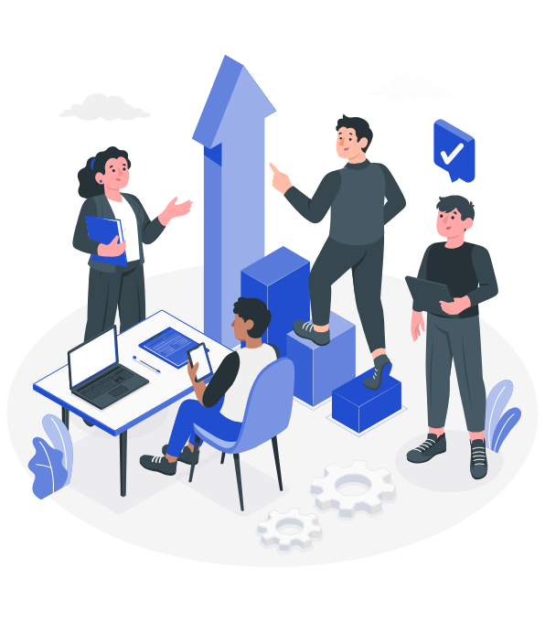
Empowering a Future-Ready Team through Mentorship and Skills Development
Building a self-sustaining team prepared for technology disruptions and growth opportunities
Team Transformation
Continuous Upskilling
Managed and mentored a cross-functional 5-member team, transforming them into a self-sustaining, multi-skilled unit capable of adapting to various challenges.
Drove continuous upskilling initiatives on the latest technology and AI trends, equipping the team to navigate and thrive in future disruptions.
Recruitment Leadership
Growth Plans
Played a pivotal role in campus and lateral hiring, managing the full recruitment process to ensure a balanced talent mix and smooth onboarding experience.
Established personalized growth plans and business knowledge sessions, ensuring each member could take ownership of multiple modules and stay relevant amidst changing tech landscapes.
Feedback Documentation
Leadership Development
Documented feedback throughout the hiring process to refine our selection criteria and improve future recruitment strategies, ensuring the right fit for the team.
One team member has progressed to lead on architecture changes, showcasing the effectiveness of coaching and empowerment in professional growth.

Slide 8





Driving Innovation with AI and Automation in Project Management
Leveraging AI to enhance efficiency and streamline onboarding processes in technology projects
Integrated Copilot enhances project architecture.
Technical sessions on AI for coding.
Transformed generic code suggestions into project-aware AI helpers, resulting in a 30% boost in code and deliverable efficiency.
01
02
Delivered sessions on leveraging AI for faster, high-quality code generation, significantly reducing onboarding and delivery timelines.
Support for new campus hires.
AI integration for NEO onboarding.
Proactively set up technical and project training, leading to faster ramp-up times and higher retention rates among new campus hires.
Actively contributed to expanding AI integration for NEO onboarding, enhancing the process with intelligent Q&A features for all hires.
03
04

Slide 9




Driving Innovation Through Strategic Initiatives at KPMG
Exploring impactful projects that enhance efficiency and stakeholder collaboration across the organization.
AI-powered NEO Onboarding revolutionizes processes.
Significantly reduced development time across 30+ screens, facilitating seamless upgrades without production incidents.
Leading the initiative to automate hiring feedback management, resulting in improved analytics and streamlined HR processes.
Stakeholder Engagement ensures project alignment.
AMP 2.0 UI Framework accelerates development.
PowerApps Automation enhances HR data flow.
Served as the core solution designer for intelligent onboarding features, now being adopted for broader applications across the organization.
Collaborated effectively across business and tech teams to align project goals, achieving recognition from both clients and leadership.

Slide 10
Vision Forward: Strategic Goals for My Next Chapter as Manager
Driving innovation and efficiency through AI and automation across KPMG initiatives
Industrialize AI Web Automation POC
Establish an AI/GenAI Team
Automate Hiring Feedback with PowerApps
Integrate AI Web Automation into live projects, delivering measurable business impact within 2 months.
Create a focused team to spearhead innovation in AMP and other platforms, enhancing project outcomes.
Complete the automation process and scale it across the organization to improve hiring efficiency.
Drive + in Efficiency Gains
Expand Team Capacity by 40%
Standardize Onboarding and Training
Focus on scaling AI and automation adoption to achieve significant annual cost savings for the organization.
Increase cross-skill coverage and enhance team resilience to support future growth initiatives effectively.
Lead efforts in creating standardized processes to ensure readiness of project teams across all initiatives.

Slide 11






Why I’m Ready for the Next Step in Leadership
Demonstrating impact and innovation for future growth and efficiency.
Key Attributes For Leadership Readiness
Demonstrated Impact: Achieved critical results under pressure.
Innovation-Driven: Pioneered the use of technology and AI.
Team Builder: Developed a high-performing team.
Strategic Vision: Integrated technology with business processes.
Ready to Lead at Scale: Prepared for managerial responsibilities.
Successfully delivered essential business outcomes, showcasing resilience and problem-solving abilities.
Focused on nurturing talent and ensuring team readiness for future challenges and opportunities.
Regularly adopted cutting-edge technologies to address pressing business challenges effectively.
Aligning technological advancements with people and processes to create lasting business value.
Eager to expand my impact by driving innovation and efficiency as a manager at KPMG.

Slide 12




Together, let’s embrace innovation for a successful future.
At KPMG, we are embarking on an exciting new chapter. Together, we will leverage innovation, technology, and teamwork to drive efficiency, scalability, and success in all our projects. Let’s collaborate to reach new heights and achieve outstanding results.

